Slide 1
MSc Applied Data Science
Cuno S.P.M. Uiterwaal, MD PhD
Introduction to epidemiological research
November 2020

Slide 2
Course Menu
Four lectures (50 min each):
What is epidemiology?
Measuring disease
Design of data collection
Biases
Diagnostic research
Prognostic research

Slide 3
The flow of epidemiologic research
Starting from research question
Design of the occurrence relation
Collection of data (empirical)
Data analysis and scientific interpretation

Slide 4
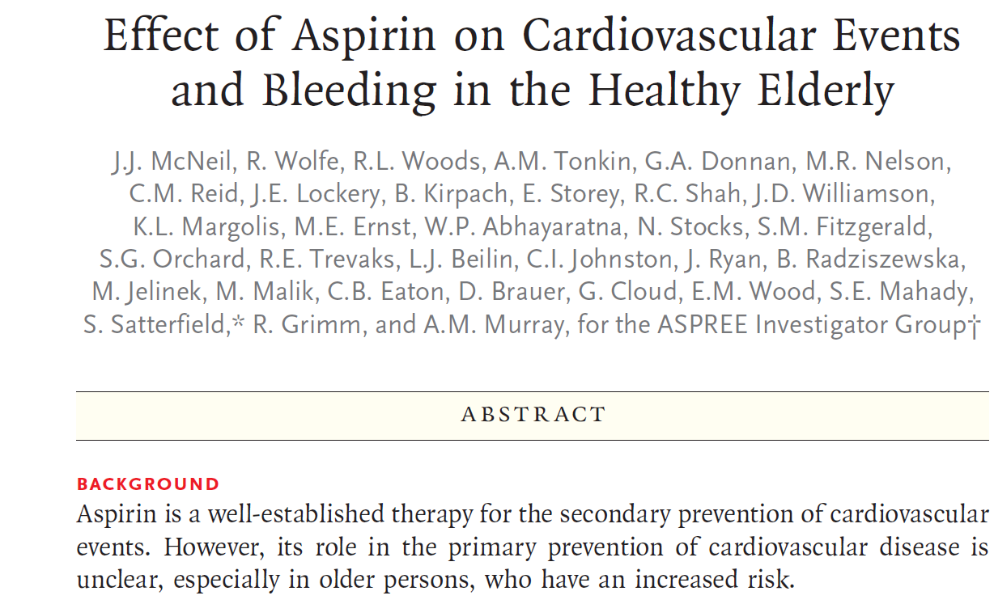
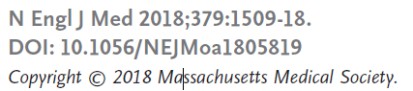
Research question
KNOWN
UNKNOWN

Slide 5
Three elements involved in research question
Outcome CVD events & bleeding
Determinant(s) Aspirin
Domain Healthy elderly

Slide 6
Epidemiology is occurrence research
Outcome…
In relation to (as a function of)…
Determinant(s)
Outcome = f (Determinant(s))
Example: CVD Events = f (Aspirin)
Bleeding = f (Aspirin)
For a given type of patient or population (domain)
Conditional on confounders

Slide 7
Study domain
Type of situation for which the occurrence relation is to be studied.
Study domain refers to generalizability of the empirical (= observed) relation.
Extent to which knowledge obtained in a particular type of subject may be generalized to another (larger, theoretical, abstract) group of subjects.

Slide 8
Effect of Aspirin on Cardiovascular Events and Bleeding in the Healthy Elderly
So findings observed in…..
METHODS From 2010 through 2014, we enrolled community-dwelling men and women in Australia and the United States who were 70 years of age or older (or ≥65 years of age among blacks and Hispanics in the United States) and did not have cardiovascular disease, dementia, or disability.
Findings generalized to ….
CONCLUSIONS The use of low-dose aspirin as a primary prevention strategy in older adults resulted in ……
➔ Study domain: older (healthy) adults

Slide 9
The flow of epidemiologic research
Starting from research question
Design of the occurrence relation
Collection of data (empirical)
Data analysis and scientific interpretation

Slide 10
What is the occurrence relation?

Slide 11
Occurrence relation
Outcome = f (Determinant(s))
Vascular damage = f(air pollution | confounding)

Slide 12
What is the occurrence relation?

Slide 13
Occurrence relation
Outcome = f (Determinant(s))
Fractures = f(antidepressants | confounding)

Slide 14
DEPTH model
Applications of epidemiology
What’s wrong with this patient?
diagnostic knowledge
Why is this patient ill?
etiologic knowledge
What will happen if I don’t intervene?
prognostic knowledge
What will be the effects of an intervention?
therapeutic (prognostic!) knowledge
➔ DEPTh model

Slide 15
Growth 17th to 19th centuries
1600AD | John Graunt | London bills of mortality analysis.
1747 | James Lind | Citrus fruits to cure scurvy in sailors.
1796 | Edward Jenner | Trial with cowpox vaccine.
1880 | W.H. Frost | Explained interplay of factors causing epidemics.
1889 | William Farr | Analysis of vital statistics & effects of imprisonment in prisoners.
1849 | John Snow | Natural experiment on London cholera.
1881 | Finlay | Mosquito borne nature of yellow fever.
1950s | Bradford Hill. A | Concept of randomization & smoking and lung cancer experiments.

Slide 16
Present
Particularly with respect to complex chronic disease:
Strong effects between single determinants and disease occurrence (smoking and lung cancer etc) are largely established
(Epidemiologic) search for disease causes continues
Shift towards research into combined causes

Slide 17

N Engl J Med 2016;375:2349-58.
DOI: 10.1056/NEJMoa1605086

Slide 18
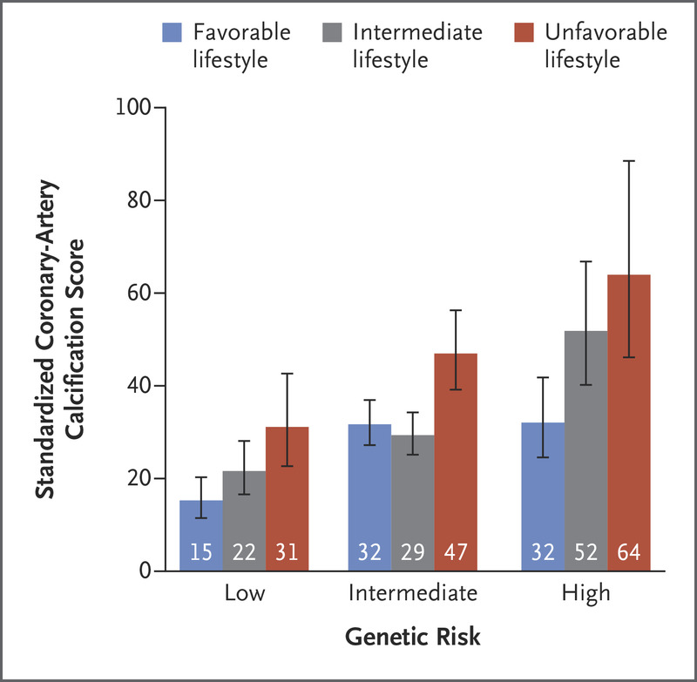
Present

Slide 19

Future
Measurements capacity grows strongly, e.g.
(epi)genetics
Microbioma
Environmental influences (exposome research)
Precision medicine
Volume of measurements (‘big data’)

Slide 20
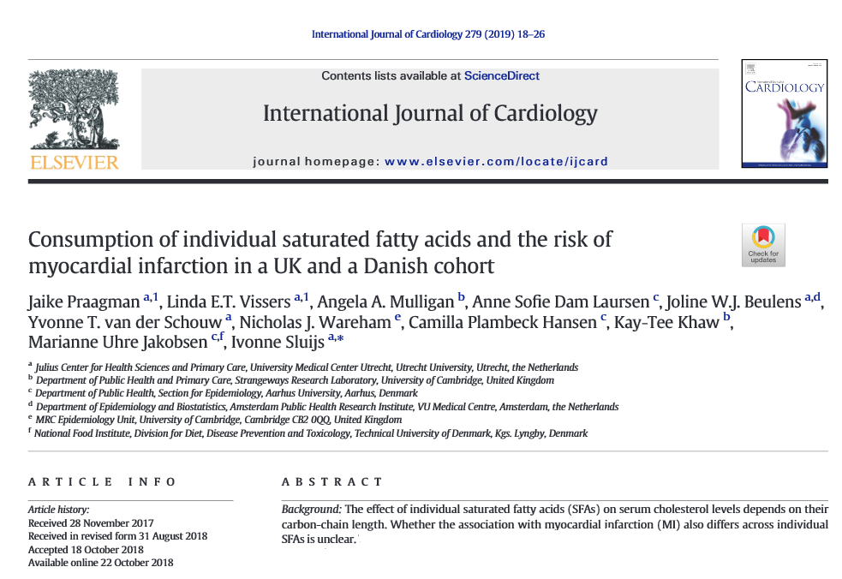
Exercise 1: research question
Voorbeeld 1

Slide 21
Exercise 1 research question + occurrence relation
Does the occurrence of myocardial infarction depend of variation in SFA’s intake in humans?
Outcome: myocardial infarction
Determinant: variation in intake of SFAs
Domain: humans
MI = f(SFA variation | confounders)

Slide 22
So,
Epidemiology is occurrence research
It all starts with a good research question
The research question largely dictates the occurrence relation, design of data collection (study design proper), data analysis
Epidemiology has a long history, will continue to play a role in an increasingly more sophisticated research setting

Slide 23
MSc Applied Data Science
Cuno S.P.M. Uiterwaal, MD PhD
Introduction to epidemiological research
November 2020

Slide 24
The flow of epidemiologic research
Starting from research question
Design of the occurrence relation
Collection of data (empirical)
Data analysis and scientific interpretation

Slide 25
Measures
Measures of frequency
Measures of association
Measures of impact

Slide 26
Overview of frequency and association measures
Frequency measures | Association measures | Impact measures
Prevalence |  | Attributable risk
Cumulative incidence | Relative risk | Population attributable risk
Incidence density | Relative rate
Odds | Odds ratio

Slide 27
Measures of frequency
Prevalence
Incidence

Slide 28
Remember:

Slide 29
Fractures = f(antidepressants)
To be measured:
“Use of antidepressants” (yes/no)
➔ What basic information/ frequency measure that you need comes to mind?

Slide 30
Prevalence in our study
Number of people using anti depressants now
Population (at risk) now
Proportion of the population presently using anti depressants.
Expressed as a percentage:
(number of anti depressant users) / (population) * 100

Slide 31
Prevalence
Provides estimate of the probability or risk that one will be ill at a point in time.
Provides an idea of how severe a problem may be: “disease burden”.
Useful for planning health services (facilities, staff), planning of health care activities.

Slide 32
Prevalence, examples
5% of subjects ≥ 55 yrs have had a stroke.
10% of Dutch people use a lipid-lowering agent.
20% of ≥ 16 yrs Dutch are vaccinated against influenza.
20% of lab technicians have work related allergy.
3.5% of wild birds in Africa have avian influenza virus.

Slide 33
fractures = f(antidepressants)
To be measured:
“risk of osteoporotic and non-osteoporotic fractures”
➔ What basic information/ frequency measure that you need comes to mind?
How often do fractures occur?
What is the incidence of fractures?

Slide 34
Crude (naïve) estimation
http://www.dub.uu.nl/
# at risk for fracture |  | # fractures
20 |  | 2
What is the 10 year risk for fracture?
2/20 = 10%
The 10-yr cumulative risk = 10%
10% chance of a fracture occurring in 10 years

Slide 35
Cumulative incidence
Proportion, fraction, %
Risk, chance, probability of disease (0 - 1)
Time specification essential
Define population “at risk”
Complete follow-up

Slide 36
Suppose this was the actual 10 years experience for our 20 patients at risk
Person | year | year | year | year | year | year | year | year | year | Year
 | 1 | 2 | 3 | 4 | 5 | 6 | 7 | 8 | 9 | 10
A |  | Fracture
B |  |  |  | Died
C |  |  |  |  |  |  |  |  |  | Alive
D |  |  |  |  |  | Lost f-up
E |  |  |  |  |  |  |  |  |  | Alive
F |  |  |  |  |  |  |  |  |  | Alive
G |  |  |  |  |  |  |  |  | Died
H |  |  |  |  |  |  |  |  |  | Alive
I |  |  |  |  |  |  |  | Lost f-up
J |  |  |  |  |  |  |  |  |  | Alive
K |  |  |  |  |  |  |  |  |  | Alive
L |  |  |  |  |  |  |  |  |  | Alive
M |  | Died
N |  |  |  |  |  |  |  |  |  | Alive
O |  |  |  | Lost f-up
P |  |  |  |  |  |  |  | Fracture
Q |  |  |  |  |  |  |  |  |  | Alive
R |  |  |  |  |  |  |  |  |  | Alive
S |  |  |  |  |  |  |  |  |  | Alive
T |  |  |  |  |  |  |  |  |  | Alive

Slide 37
Towards less naïve estimation
The naïve 10 yr estimation of 2/20 assumes:
2 (first) fractures occurring in 20*10 = 200 years total observation time
While actually the 2 fractures occurred in 176 years total observation time (200 – 33)
http://www.handboekbuitenpromoveren.nl

Slide 38
Towards less naïve estimation
So naïve cumulative incidence estimation = underestimation of real risk
Solution:
Cut up follow-up time into small sections (e.g. 1 year). Within such cuts things are more stable and calculate CI’s within subsequent years, accounting for changing # of people at risk over time
Life table analysis: CI = 0.12 (≠ naïve 0.10)
http://www.handboekbuitenpromoveren.nl

Slide 39
Incidence
Incidence density (ID):
The number of occasions of disease onset in the population divided by time period of observation
Density; not a proportion (unit person-years)
Risk estimation?
# new cases / person years of population at risk
10 per 1000 person years
between 0 and infinity

Slide 40
Incidence density: our example
Person | year | year | year | year | year | year | year | year | year | Year
 | 1 | 2 | 3 | 4 | 5 | 6 | 7 | 8 | 9 | 10
A |  | Fracture
B |  |  |  | Died
C |  |  |  |  |  |  |  |  |  | Alive
D |  |  |  |  |  | Lost f-up
E |  |  |  |  |  |  |  |  |  | Alive
F |  |  |  |  |  |  |  |  |  | Alive
G |  |  |  |  |  |  |  |  | Died
H |  |  |  |  |  |  |  |  |  | Alive
I |  |  |  |  |  |  |  | Lost f-up
J |  |  |  |  |  |  |  |  |  | Alive
K |  |  |  |  |  |  |  |  |  | Alive
L |  |  |  |  |  |  |  |  |  | Alive
M |  | Died
N |  |  |  |  |  |  |  |  |  | Alive
O |  |  |  | Lost f-up
P |  |  |  |  |  |  |  | Fracture
Q |  |  |  |  |  |  |  |  |  | Alive
R |  |  |  |  |  |  |  |  |  | Alive
S |  |  |  |  |  |  |  |  |  | Alive
T |  |  |  |  |  |  |  |  |  | Alive
Incidence density = 2 / 176 person years

Slide 41
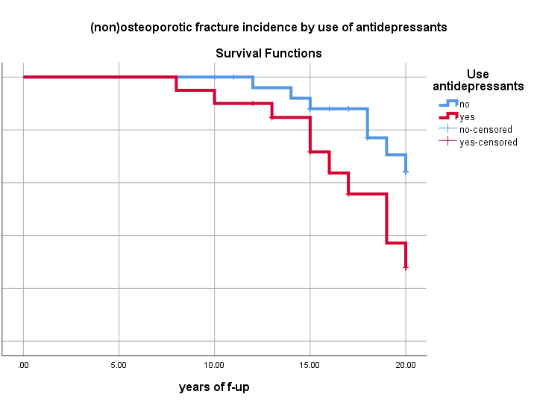
Kaplan Meier

Slide 42
Our example
Risk (cumulative incidence): 10%
Risk _{lifetable} (cumulative incidence): 12%
Rate (incidence density): 2/176 person- years
http://www.handboekbuitenpromoveren.nl

Slide 43
Item | Prevalence | Cumulative incidence | Incidence density
Numerator | All cases counted on a single occasion | New cases occurring during a specified follow-up period | New cases occurring during a specified follow-up period
Denominator | All individuals examined - cases and non-cases | All susceptible individuals present at the start of the study | Sum of time periods during which all individuals could have developed disease
Time | Single point or period | Defined period | Measured for each individual from beginning of study until disease event
Interpretation | Probability of having disease at a point in time | Probability of developing disease over a specified period | How quickly new cases develop over a specified period

Slide 44
Use cumulative incidence or incidence density?
Cumulative incidence (CI) is a proportion, a risk, a chance (intuitively easy to use)
Incidence density (not intuitively easy to use)
Over small time periods CI ≈ ID because over small time periods incidence is always low.

Slide 45
Use cumulative incidence or incidence density?
Over long f-up, CI not ideal because
Not equal f-up for all, competing risks
Better estimate ID/rates
Therefore cumulative incidences over (small) time units often referred to as rates, e.g.

Slide 46
By the way
http://www.dub.uu.nl/
# at risk for fracture |  | # fractures
20 |  | 2
What is the 10 year (outcome) odds for fracture?

Slide 47
By the way: Odds
Probability that an event will happen
Probability that an event will not happen

Slide 48
By the way
# at risk for fracture |  | # fractures
20 |  | 2
http://www.dub.uu.nl/
10-year (outcome) Odds =(2/20) / (18/20) = 0.11
Sometimes used instead of real risks because statistical models (Logistic regression)
Exposure odds used in designs in which risks cannot be directly estimated
Use real risks where you can…..

Slide 49
Measures of association

Slide 50
Risk ratio: suppose our study findings
Anti depressants | Fracture | No fracture | Total
Yes | 70 (a) | 1,930 (b) | 2000
No | 30 (c) | 1,970 (d) | 2000
Risk Ratio (RR) using Cumulative Incidence (CI):
a/(a+b) 70/2,000
= = 2.3 (95% CI: 1.35 – 3.90)
c/(c+d) 30/2,000

Slide 51
Interpretation of Relative Risk
1 = No association between exposure and disease
risks or rates are identical between groups
> 1 = Positive association
< 1 = Negative association or protective effect
Example: .5 = half as likely to experience disease

Slide 52
Risk ratio: our study
Anti depressants | Fracture | No fracture | Total
Yes | 70 (a) | 1,930 (b) | 2000
No | 30 (c) | 1,970 (d) | 2000
RR using Cumulative Incidence (CI):
Use of anti depressants is associated with a 2.3 times higher risk of osteoporotic and non-osteoporotic fractures

Slide 53
Risk ratio or rate ratio
For short follow-up, easy interpretation of risk ratio.
For long follow up: risk ratio suffers from limitations of CI estimation.
For etiologic research; rate ratio often preferred.

Slide 54
Rate ratio: our study
Anti depressants | Fracture | Person-years
Yes | 70 | 15,930
No | 30 | 14,800
70/15,930py
= = 2.2
30/14,800py

Slide 55
Rate ratio: our study
Anti depressants | Fracture | Person-years
Yes | 70 | 15,930
No | 30 | 14,800
Use of anti depressants is associated with a 2.2 times higher risk of osteoporotic and non-osteoporotic fractures

Slide 56
Measures of impact
Absolute measures
Relative measures
Measures of impact aim to indicate numbers of cases (fractures) or fractions of risk that could be prevented if the exposure (antidepressants) were eliminated,
but ………..
Beware of criticism:
Only if exposure really causes outcome
Elimination often (very) unrealistic

Slide 57
Summary
Measure of frequency
Prevalence
Incidence
Incidence estimates (crude to precise)
Measures of association
Measures of impact

Slide 58
Repetition: The flow of epidemiologic research
Starting from research question
Design of the occurrence relation
Collection of data (empirical)
Data analysis and scientific interpretation

Slide 59
“Epidemiologic research and design of occurrence relation & data collection”
Confounding
Measurement theory (probably elsewhere in course)
Introduction to epidemiological research
59
Notes:
59

Slide 60
Research question
Is the risk of (non-)osteoporotic bone fractures increased in users of antidepressants (in humans)?

Slide 61
Occurrence relation
I (fractures) = f (antidepressants | confounders)
………………………………………………...| confounders)

Slide 62
Etiologic research
Regardless of type of data collection:
Inference about: fractures = f (antidepressants)
is either:
correct
or
Incorrect (biased)

Slide 63
What is bias?
fractures = f (antidepressants)
Suppose:
You find that indeed antidepressants are related to increased incidence of fractures
Proper scientific scrutiny would/will ask:
is that finding true or biased?

Slide 64
What is bias?
Bias is the result of any process that ‘confounds’ the relation, so in findings about:
fractures = f (antidepressants)
There may have been:
Confounding
Latin: confundere (“mixing together”)
Other bias
Selection bias
Observation bias

Slide 65
What is bias?
There may have been:
Confounders
Intrinsic in nature (data), to be dealt with in
analysis, (if you measure it accurately !!!!) or
type of data collection: randomized controlled trial (RCT) (see later)
Other bias
selection bias, observation bias, to be dealt with by valid data collection

Slide 66
Etiologic research
So therefore,
I (fractures) = f(antidepressants | confounding)
Occurrence relation includes conditionality on confounding
Provided that other sources of bias can be (must be) prevented in the study design phase

Slide 67
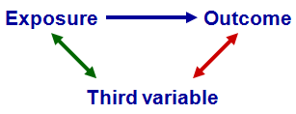
Confounding
To be a confounding factor, the underlying conditions must be met:
Be associated with exposure
Without being the consequence of exposure
Be associated with outcome
Independently of exposure
Introduction to epidemiological research
67
Notes:
67

Slide 68
A confounder:
Predicts occurrence of outcome (not necessarily causal, ex. SES)
Is associated with the determinant
Is extraneous to the occurrence relation
In case of confounding, the association needs to be present conditional on the confounding factor (= irrespective the presence or absence of the confounder).
Introduction to epidemiological research
68
Notes:
68

Slide 69
Risk ratio: our study
Anti depressants | Fracture | No fracture | Total
Yes | 70 (a) | 1,930 (b) | 2,000
No | 30 (c) | 1,970 (d) | 2,000
RR using Cumulative Incidence (CI):
a/(a+b) 70/2,000
= = 2.3 (95% CI: 1.35 – 3.90)
c/(c+d) 30/2,000

Slide 70

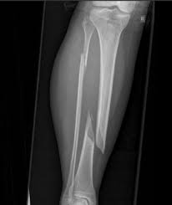
Remember
?
Confounding factor:
Physical activity

Slide 71
Physical activity | Antidepressants | No anti depressants
Low | 550 (55%) | 300 (30%)
High | 450 | 700
Physical activity | Fractures | No fractures
Low | 370 (44%) | 480
High | 130 (11%) | 1020
Introduction to epidemiological research
71
Notes:
71

Slide 72
Low physical activity
Anti depressants | Total | Fractures | AR % | RR, 95% CI
Yes | 550 | 250 | 45.5 % | 1.14 (0.9 – 1.3)
No | 300 | 120 | 40.0 %
High physical activity
Anti depressants | Total | Fractures | AR % | RR, 95% CI
Yes | 450 | 50 | 11.1 % | 0.97 (0.7 – 1.4)
No | 700 | 90 | 11.4 %
Crude RR = 2.3
Adjusted RR = 1.1 (0.94 - 1.27)
Notes:
72

Slide 73
A confounder:
Predicts occurrence of outcome (not necessarily causal, ex. SES).
Is associated with the determinant.
Is extraneous to the occurrence relation.
In case of confounding, the association needs to be present conditional on the confounding factor (= irrespective the presence or absence of the confounder).
Meaning ???
Notes:
73

Slide 74
Remember
?
NOT HERE !!!!
Confounding factor:
Physical activity

Slide 75
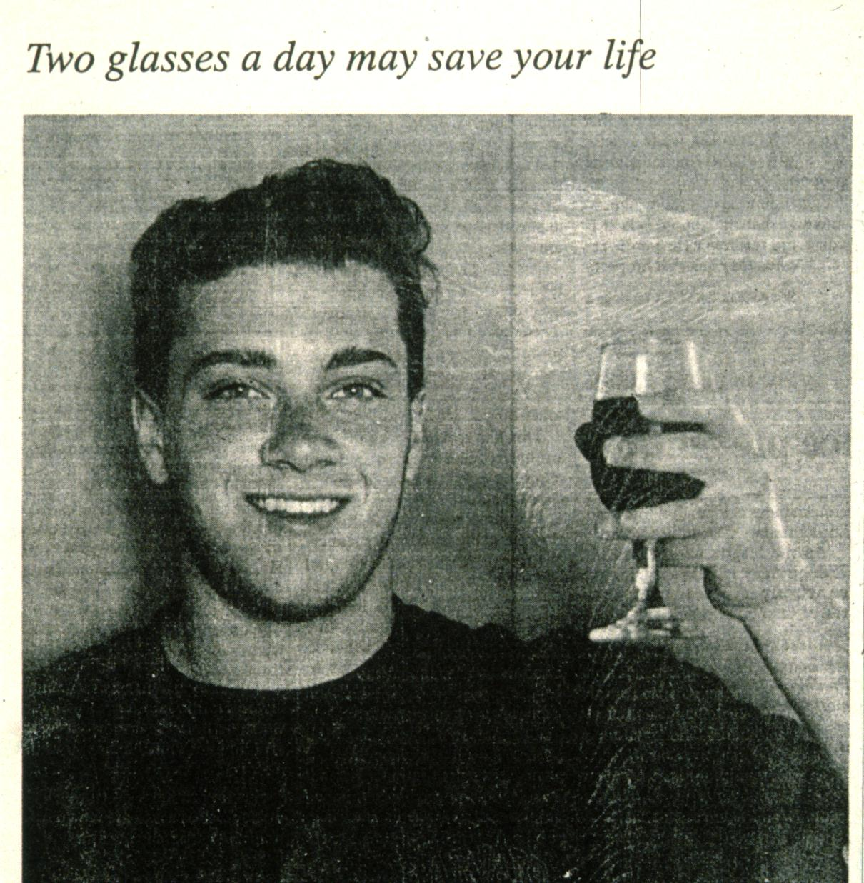
Alcohol and risk of fatal myocardial infarction Example
Confounders:..........
Heavy alcohol users have a higher HDL cholesterol and a higher blood pressure.
Adjustment indicated?
Notes:
75

Slide 76
Judgement of potential for confounding requires view (or knowledge) on etiologic mechanisms involved
Statistical software can not decide what a confounder is
In causal research:
Burden on the investigator to exclude confounding (in design and analysis) Bias is a quantitative issue
Notes:
76

Slide 77
Remember: Risk ratio
Anti depressants | Fracture | No fracture | Total
Yes | 70 (a) | 1,930 (b) | 2000
No | 30 (c) | 1,970 (d) | 2000
RR using Cumulative Incidence (CI):
a/(a+b) 70/2,000
= = 2.3 (95% CI: 1.35 – 3.90)
c/(c+d) 30/2,000

Slide 78
Measurement
2.3 (95% CI: 1.35 – 3.90)
Question 1: is 2.3 valid (‘true’) ? (no confounding, other bias)
Question 2: how precise is 2.3?
Confidence Interval (1.35 – 3.90), function of:
# observations (participants) (i.c. statistical power)
accuracy of measurements
the narrower the more precise

Slide 79
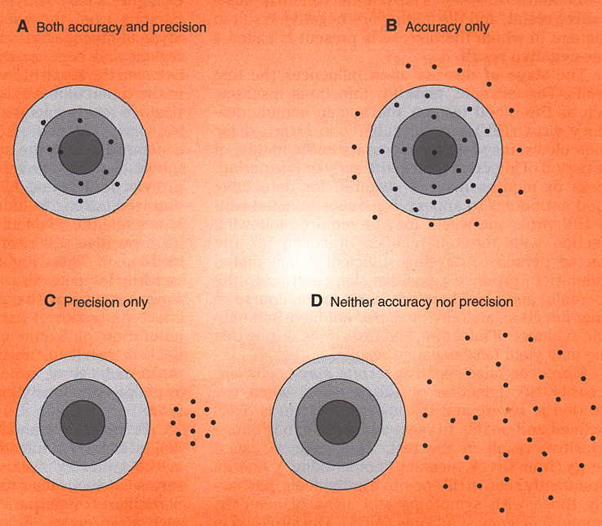
Validity and precision

Slide 80
The flow of epidemiologic research
Starting from research question
Design of the occurrence relation
Collection of data (empirical)
Data analysis and scientific interpretation

Slide 81
Real question underlying any (etiologic) occurrence relation
What would have happened with respect to outcome if people had not been exposed, ‘everything else being equal’?
‘take exposed people back in time and unexpose them’ (or vice versa)

Slide 82
Question underlying any occurrence relation
Any study design is approximation:
compare exposed with other non-exposed for outcome experience
Non experimental cohorts/case-controls: deal with relevant incomparability in design and/or analysis
Experimental cohort: deal with relevant incomparability by design (randomization)

